Slide 1
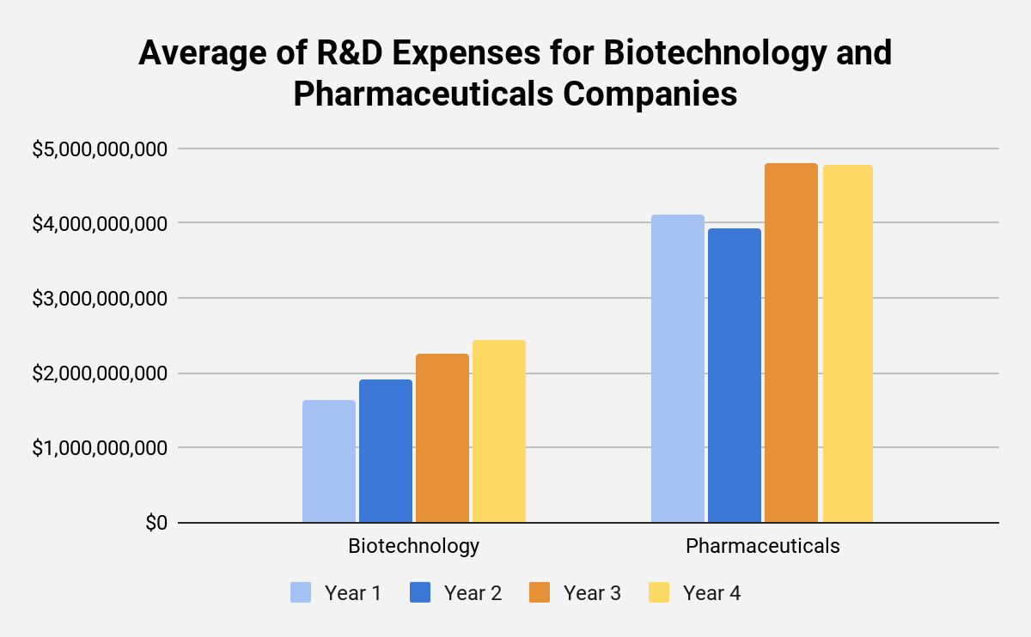
Does the Biotechnology or Pharmaceuticals Industry Spend More on R&D?
This graph depicts the mean R&D expenditure of companies within the biotechnology industry and the pharmaceuticals industry.
The data clearly indicates that, by every measure of central tendency, companies within the pharmaceuticals industry had a considerably higher average R&D expenditure than those within the biotechnology industry.
Measures of spread like the standard deviation and range indicate that the amount of money the biotechnology industry spends each year varies a bit more than that of the pharmaceuticals industry. This is likely due to the consistent growth in this area that can be easily recognized when looking at the graph.
https://docs.google.com/spreadsheets/d/1yUO13hWBHDXexEbxSx9xPC8U93cFSc0MJtQrtXajcPc/edit?usp=sharing
Works Cited: N/A

